Slide 1
Advanced Game Engine Creation
Lecture 2
Maths for 3D Worlds

Slide 2
Objectives
Last week we:
introduced the module
quickly reviewed C++
introduced OpenGL and its incorporation into the SDL framework
using OpenGL functions to display triangles and 3D shapes
In this lecture, we will
review 3D points and vectors
look at vector operations – addition, subtraction, scalar multiplication
discuss C++ operator overloading
create a 3D vector struct with overloaded operators
introduce matrices
multiplying vectors by matrices
multiplying matrices together

Slide 3
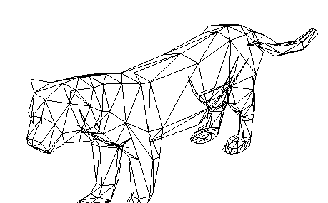
Why maths?
game world is represented in 3D space by models made up of triangles made up of vertices

Slide 4
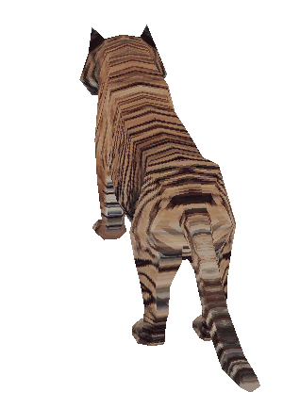
Every frame:
3D viewing is like taking a picture with a camera
2D picture
Camera
use user input, physics, AI, animation to update position of game objects
render view of 3D game world as a 2D picture
3D scene

Slide 5
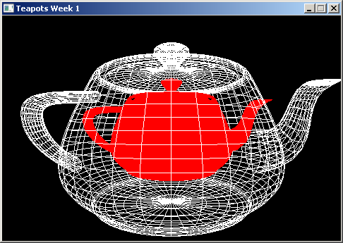
Last week – the teapot scene
how can we:
display teapots in different positions?
rotate and scale them?
render the solid teapot so it doesn't look flat?

Slide 6
The secret of 3D rendering
we keep only one copy of each model
Ideally centred on the origin
each model is scaled, rotated and placed into position every frame
then rendered and discarded
multiple times to display multiple objects
start afresh next frame

Slide 7
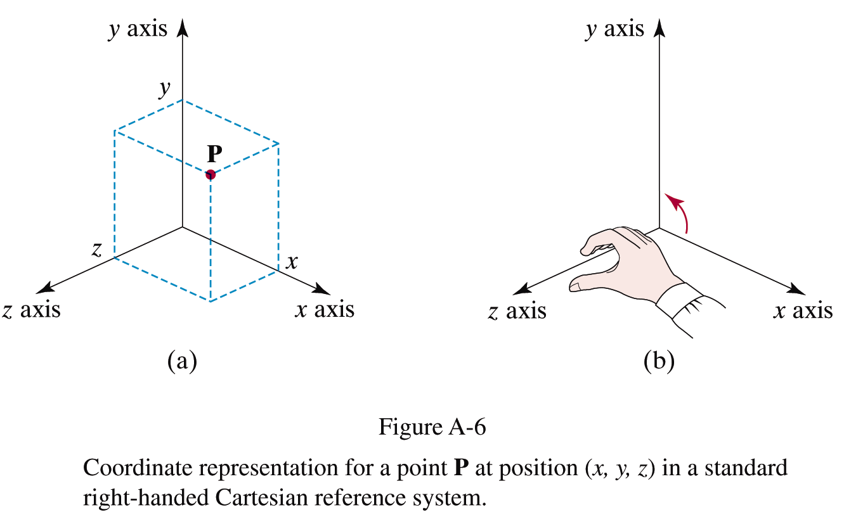
Right-handed 3D coordinates
the positive z axis comes out of the screen/paper
used by OpenGL
Notes:
Maya is righthanded

Slide 8
3D Space
We need two elements available in our 3D space
Points
These are used to define positions
An object is located at a point
A vertex is located at a point
Vectors
These are used to define directions
A viewer is looking in a certain direction
A projectile is moving in a certain direction

Slide 9
Representation of points
the location of a point in 3D space can be represented by 3 floating point numbers
(x, y, z) where x, y and z are floats
(0.0, 0.0, 0.0) the origin
represented by (0.0f, 0.0f, 0.0f) in an OpenGL program
(3.2, 0.6, 4.5)

Slide 10
Vectors
A vector refers to a quantity that possesses both magnitude and direction
45 mph north-east
4 km/h towards the pub
while a scalar just has magnitude
I have driven 18 miles
I'm 4 km from the pub
don't confuse vector the mathematical construct with vector the C++ container

Slide 11
Vectors
We graphically specify a vector by a directed line segment, where the length denotes its magnitude and the aim denotes its direction
Note that where we draw a vector is immaterial as changing its location does not change its magnitude or direction
we use unit vectors (a vector of length 1) if we are only interested in the direction
the direction an object is pointing at
the direction of a vector perpendicular
to a surface (for lighting)

Slide 12
Vectors
Computers cannot work with vectors geometrically, therefore we need to represent them numerically
So, in our 3D space we
Define some point as the origin (0, 0, 0)
Assume basis vectors for this 3D space
Translate all vectors so that their tails are at this origin
This is called standard position
We can now represent a vector as the coordinates of its head v = (x, y, z)
Our vector is now defined relative to our 3D coordinate system with origin at (0, 0, 0)

Slide 13
Vectors and Points
Both vectors and points can be described by coordinates (x, y, z) relative to a frame.
However, they are not the same
A point represents a location in 3D-space, whereas a vector represents a magnitude and direction

Slide 14
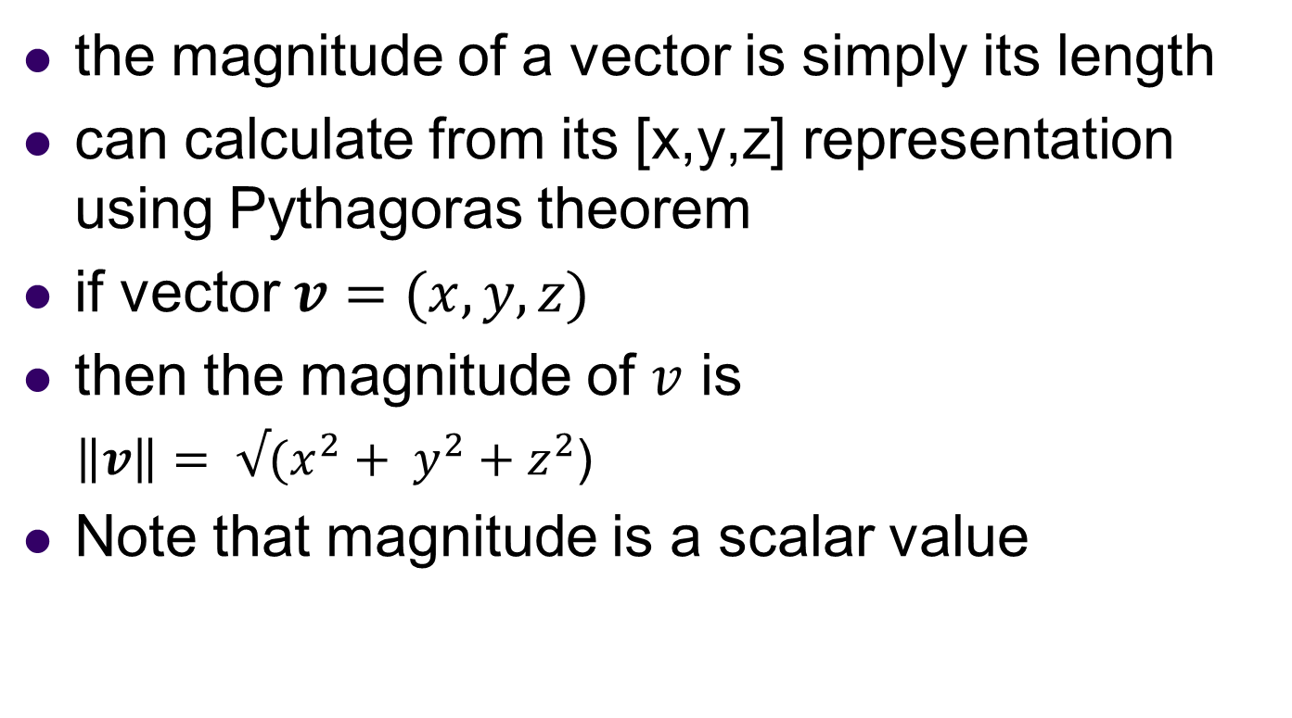
Vector magnitude
the magnitude of a vector is simply its length
can calculate from its [x,y,z] representation using Pythagoras theorem
if vector $v=(x,y,z)$
then the magnitude of $v$ is
$\left\|v\right\|= √(x^{2}+ y^{2}+z^{2}$)
Note that magnitude is a scalar value

Slide 15
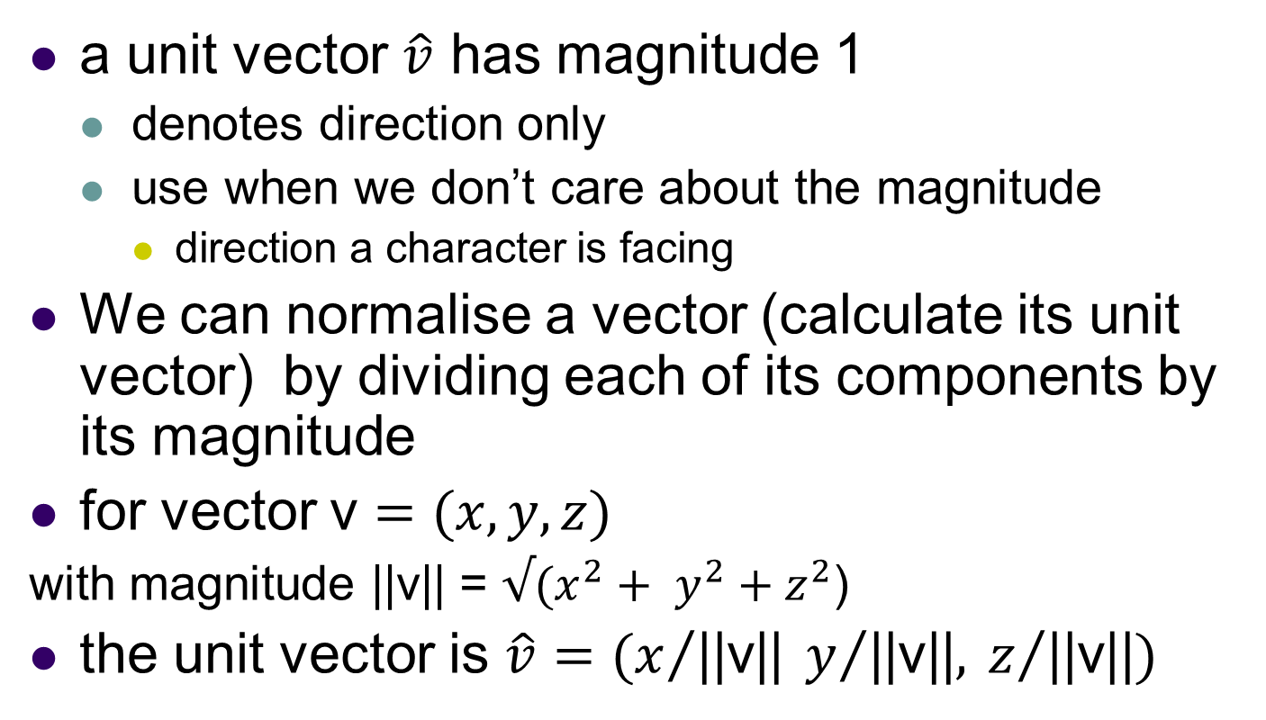
Unit vectors
a unit vector $\hat{v}$ has magnitude 1
denotes direction only
use when we don’t care about the magnitude
direction a character is facing
We can normalise a vector (calculate its unit vector) by dividing each of its components by its magnitude
for vector v $=(x,y,z)$
with magnitude ||v|| = $√(x^{2}+ y^{2}+z^{2}$)
the unit vector is $\hat{v}=(x/{\text{||}\text{v}\text{||}}{ y}/{\text{||}\text{v}\text{||}, }z/{\text{||}\text{v}\text{||}})$

Slide 16
Worked example
calculate the magnitude of the vector (3, 5, 4)
calculate the unit vector corresponding to the vector (3, 5, 4)
Notes:
magnitude = 7.07 unit vector (0.424, 0.707, 0.566) check – magnitude of the unit vector is 1

Slide 17
Vectors
Given points P and Q, we can easily find the vector that lies between them
The vector is Q – P
Note the direction of (Q – P) is from P to Q
when P is the origin (0,0,0), the point Q has the same coordinates as the vector between P and Q
Q
Q - P
P

Slide 18
Worked example
calculate the vector PQ between the points
P = (3, 6, -2) and Q = (-4, 2, 0)
Notes:
PQ = (-4 – 3, 2 – 6, 0 – (-2)) = (-7, -4, 2)

Slide 19
Vector addition
If we add two vectors together we get another vector as follows
Let a = (a_{x}, a_{y}, a_{z}) and b = (b_{x}, b_{y}, b_{z})
Then a + b= (a_{x} + b_{x}, a_{y} + b_{y}, a_{z} + b_{z})
multiple forces acting on an object
a translation of a position a by a vector b
b
a + b
a

Slide 20
Worked example
calculate the new position of a point (-4, 6, 0) translated by the vector (2, 3, 4)
Notes:
new P = (-4+2, 6+3, 0+4) = (-2, 9, 4)

Slide 21
Vectors
We can multiply vectors by scalars
If we multiply a vector v by a scalar t we get a vector tv which is
Parallel to v
t times the length of v
Let t be a scalar, and let v = (v, v_{y}, v_{z})
Then tv = (tv_{x}, tv_{y}, tv_{z})
v
-1.25 v
1.5 v

Slide 22
Worked examples
multiply the vector (-8, 3, 2) by the scalar 2.5
multiply the vector (-8, 3, 2) by the scalar -1
what is the effect of this operation?
Notes:
answer = (-8*2.5, 3*2.5, 2*2.5) = (-20, 7.5, 5)
answer2 = (8, -3, -2) - reverses the direction of the vector

Slide 23
A Vector3D struct or class
its is a good idea to write a Vector3D struct or class which includes common vector operations
struct has public members by default, otherwise same as class
for example, simple linear motion entails the addition of two vectors every frame
position.x += velocity.x;
position.y += velocity.y;
position.z += velocity.z;
it would be neater to be able to write
position = position + velocity;
or even position += velocity;
where position and velocity are both Vector3D instances
b
a + b
a

Slide 24
Overloading operators
we can overload (write new versions of) operators in C++
similar to overloading functions
most languages don't allow you to do this (why not?)
Vector3D operator+( const Vector3D b) {
Vector3D result;
result.x = x + b.x;
result.y = y + b.y;
result.z = z + b.z;
return result;
}
usage: position = position + velocity;
where position and velocity are both instances of Vector3D

Slide 25
Overloading the += operator
Vector3D& operator += (const Vector3D b) {
x = x + b.x;
y = y + b.y;
z = z + b.z;
return *this;
}
usage position += velocity;

Slide 26
The need for matrices
it is very useful to represent transformations using matrices
rotations about an axis, translations, scaling
we can combine individual transformations by multiplying them together
we can then use the final transformation matrix M to transform all the vertices of a game object
simply multiply each vertex by M
we will cover transformations in more detail next week
this week we will just look at the mechanics of matrix multiplication

Slide 27
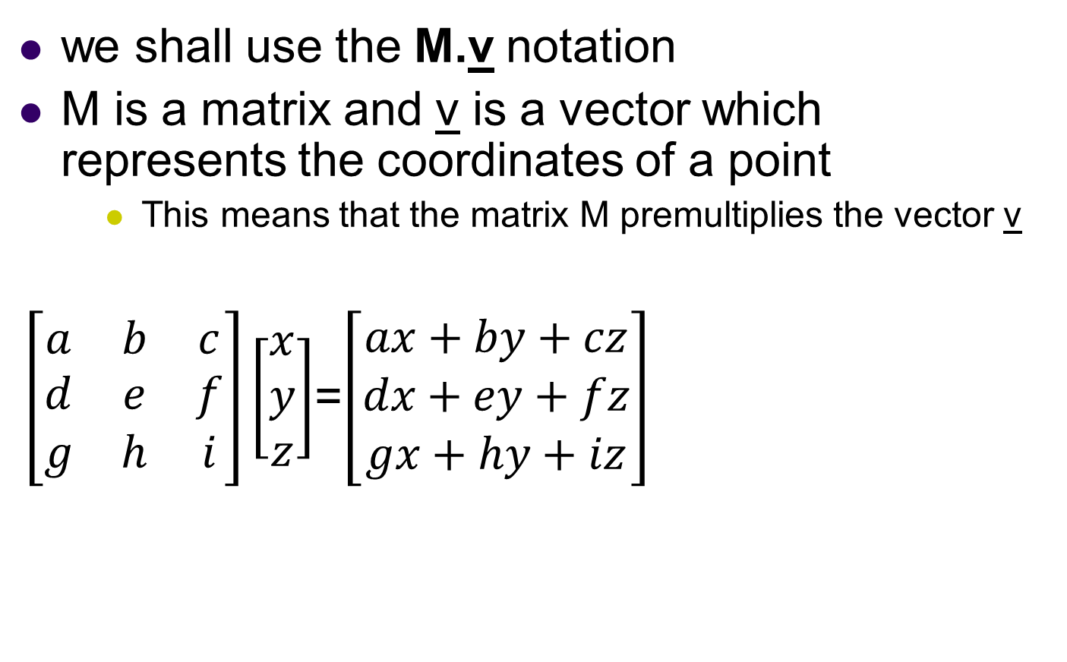
Multiplying a vector by a matrix
we shall use the M.v notation
M is a matrix and v is a vector which represents the coordinates of a point
This means that the matrix M premultiplies the vector v
$\left[\begin{matrix}a & b & c \\ d & e & f \\ g & h & i\end{matrix}\right]\left[\begin{matrix}x \\ y \\ z\end{matrix}\right]$=$\left[\begin{matrix}ax+by+cz \\ dx+ey+fz \\ gx+hy+iz\end{matrix}\right]$

Slide 28
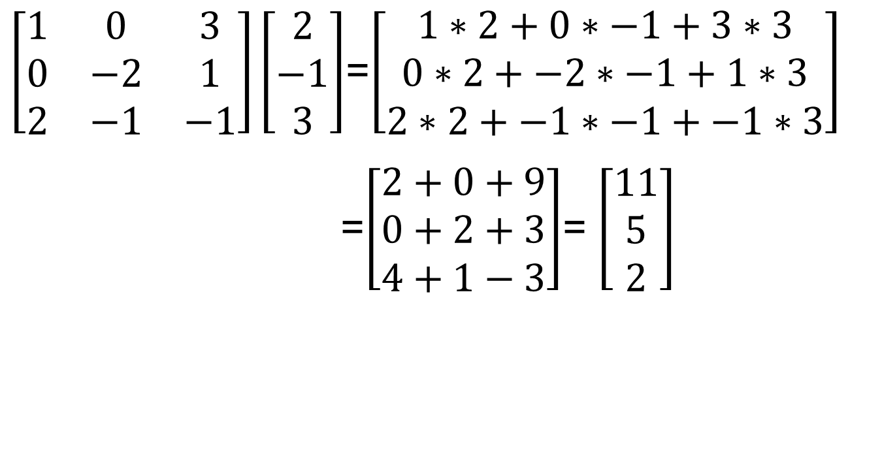
Worked example
$\left[\begin{matrix}1 & 0 & 3 \\ 0 & −2 & 1 \\ 2 & −1 & −1\end{matrix}\right]\left[\begin{matrix}2 \\ −1 \\ 3\end{matrix}\right]$=$\left[\begin{matrix}1∗2+0∗−1+3∗3 \\ 0∗2+−2∗−1+1∗3 \\ 2∗2+−1∗−1+−1∗3\end{matrix}\right]$
=$\left[\begin{matrix}2+0+9 \\ 0+2+3 \\ 4+1−3\end{matrix}\right]$= $\left[\begin{matrix}11 \\ 5 \\ 2\end{matrix}\right]$

Slide 29
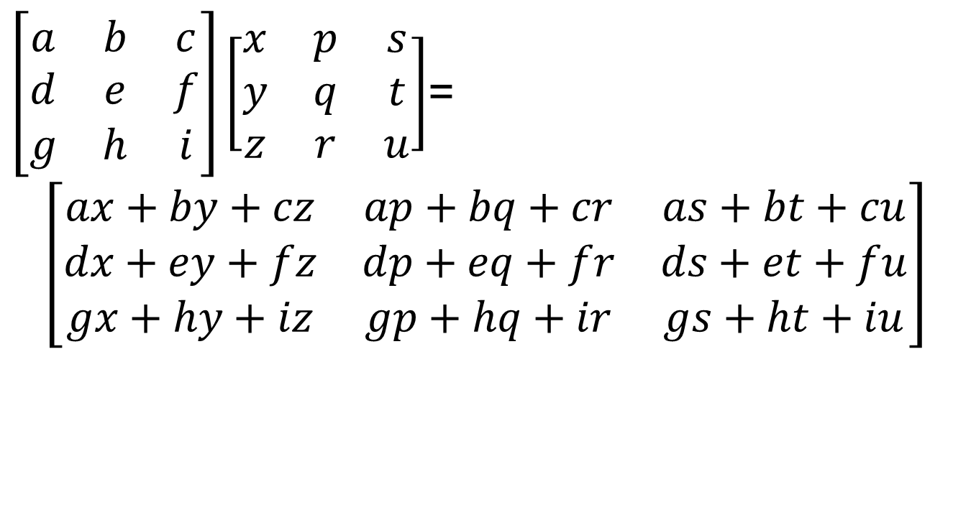
Multiplying two matrices
$\left[\begin{matrix}a & b & c \\ d & e & f \\ g & h & i\end{matrix}\right]\left[\begin{matrix}x & p & s \\ y & q & t \\ z & r & u\end{matrix}\right]$=
$$\left[\begin{matrix}ax+by+cz & ap+bq+cr & as+bt+cu \\ dx+ey+fz & dp+eq+fr & ds+et+fu \\ gx+hy+iz & gp+hq+ir & gs+ht+iu\end{matrix}\right]$$

Slide 30
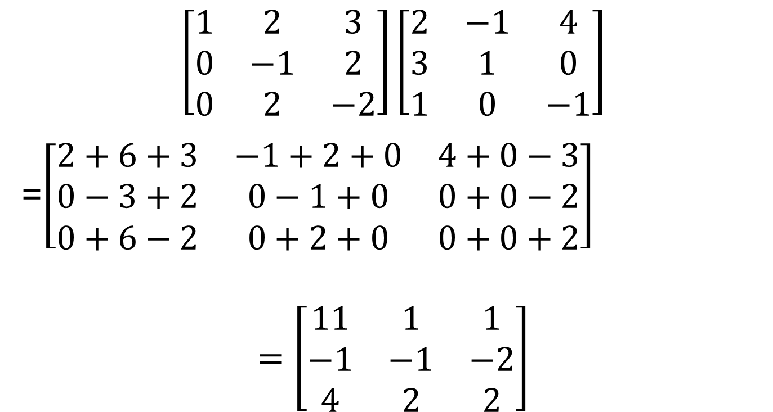
Worked example – multiplying two matrices
$$\left[\begin{matrix}1 & 2 & 3 \\ 0 & −1 & 2 \\ 0 & 2 & −2\end{matrix}\right]\left[\begin{matrix}2 & −1 & 4 \\ 3 & 1 & 0 \\ 1 & 0 & −1\end{matrix}\right]$$
=$\left[\begin{matrix}2+6+3 & −1+2+0 & 4+0−3 \\ 0−3+2 & 0−1+0 & 0+0−2 \\ 0+6−2 & 0+2+0 & 0+0+2\end{matrix}\right]$
$$=\left[\begin{matrix}11 & 1 & 1 \\ −1 & −1 & −2 \\ 4 & 2 & 2\end{matrix}\right]$$

Slide 31
Some more useful 3D maths yet to cover
vector dot and cross products
calculating the direction of a vector from its [x, y, z] representation
using matrices to represent transformations (next week)

Slide 32
Summary
Today we have
reviewed 3D points and vectors
looked at vector operations – addition, subtraction, scalar multiplication
discussed C++ operator overloading
created a 3D vector struct with overloaded operators
introduced matrices
multiplying vectors by matrices
multiplying matrices together
Practical
Pen and paper calculations
implement and test a C++ Vector3 struct
Further work
Google for vector and matrix calculators and animations!

